Slide 1
HOUSE PRICE PREDICTION USING MACHINE LEARNING
Yanda Saketh RA1911026010076
Soumyadeep Mukherjee RA1911026010078
K.S.G.Chandra Sekhar RA1911026010086
Ashwini Sharma RA1911026010090

Slide 2
ABSTRACT
With the prevalence of big data, we are able to implement simple Machine Learning techniques against datasets to solve many present issues. Utilizing the California Housing Prices dataset, we can apply linear regression models to forecast districts’ future median housing prices. As a result, homebuyers could predict if they are getting a good deal on their home, investors could predict their potential return on investments and capitalize on undervalued properties, and sellers could gauge what they could potentially sell for on the open market. To find a starting base, our research began as an independent study guided by a textbook that provides hands-on machine learning training, including one that uses the California Housing Prices dataset. From here, we are able to choose the Least Square Regression Line as our performance measure in the model—which will result in a linear equation that looks for minimizing the variance between the training set’s predictions and the actual points produced on the regression line. Once we are able to train our model to make accurate predictions from the testing set, we can expand upon this research by moving beyond linear regression and investigating different Machine Learning techniques further within the textbook to model the data in more sophisticated ways.

Slide 3
ISSUES IN EXISTING SYSTEM
Starting with 2005, the increasing interest rates in the U.S. housing market have slowed down the market considerably. Particularly, the investment bank Lehman Brothers Holdings was affected significantly, and forced into bankruptcy in 2008. This resulted in a sharp decline in the housing prices and, combined with the subprime mortgage crisis, increased the slowing down of the economy and weakened the asset values, which ultimately led to the depreciation of the global housing market and caused a global crisis . Consequently, economists turned their attention to predicting these types of threats that could jeopardize the economic stability. After the 2008 global crisis, the housing market fell for several years, especially in the large cities, until the end of 2011. Beginning with 2012, the housing market followed an upward trend with decreasing inventories, increasing demand, and naturally increasing prices. This again made economists and market analysers turn their attention to more precise prediction models to shield the economy from predictable threats that could result in economic downturns

Slide 4
PROBLEM STATEMENT
The US Census Bureau has published California Census Data which has 10 types of metrics such as the population, median income, median housing price, and so on for each block group in California. The dataset also serves as an input for project scoping and tries to specify the functional and nonfunctional requirements for it.

Slide 5
OBJECTIVE
The project aims at building a model of housing prices to predict median house values in California using the provided dataset. This model should learn from the data and be able to predict the median housing price in any district, given all the other metrics.
Districts or block groups are the smallest geographical units for which the US Census Bureau publishes sample data (a block group typically has a population of 600 to 3,000 people). There are 20,640 districts in the project dataset.

Slide 6
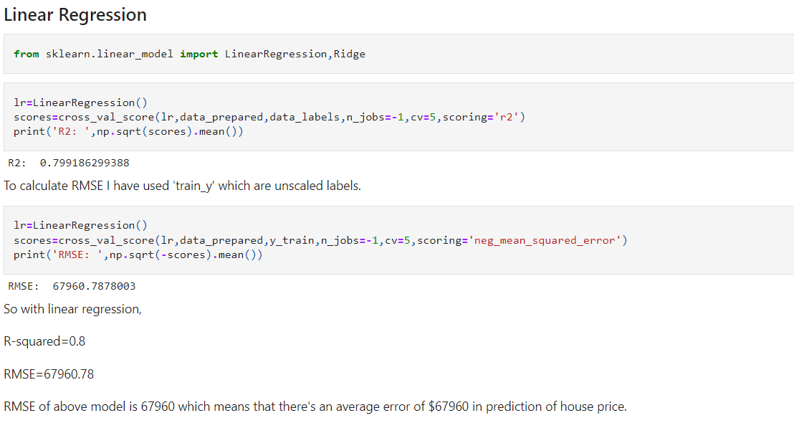
DEMO AND SCREENSHOT

Slide 7
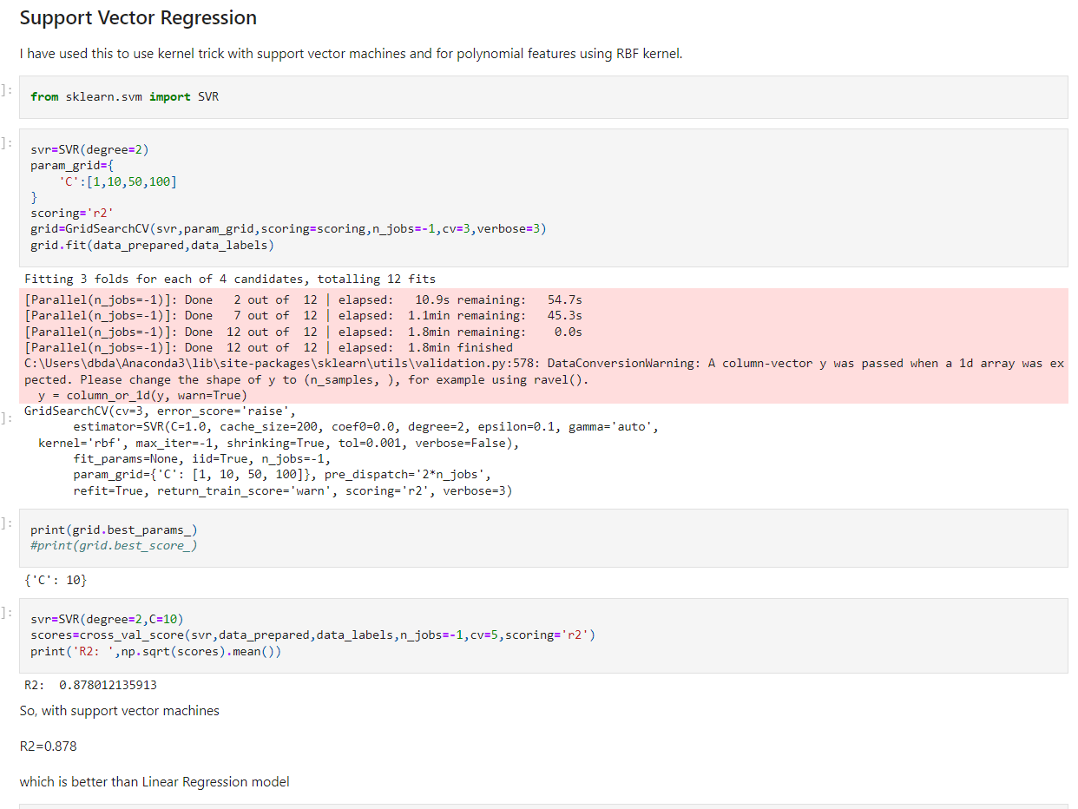

Slide 8
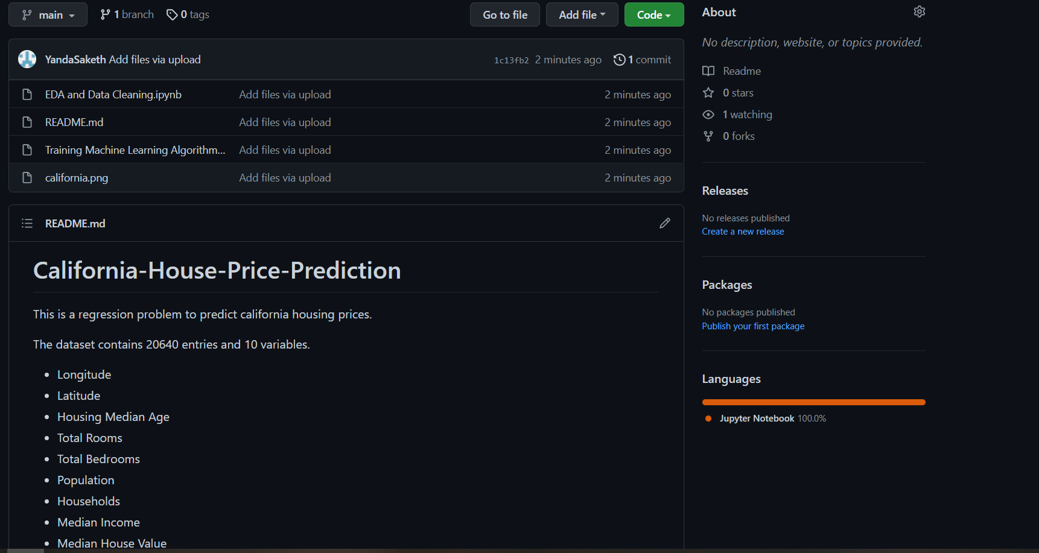
PROOF OF GITHUB UPLOAD

Slide 9
SOCIAL BENEFIT
The accurate prediction model would allow investors or house buyers to determine the realistic price of a house as
well as the house developers to decide the affordable house price

Slide 10
THANK YOU…

